Slide 1
Exam 3 Review

Slide 2
Approximation
Aida Davani

Slide 3
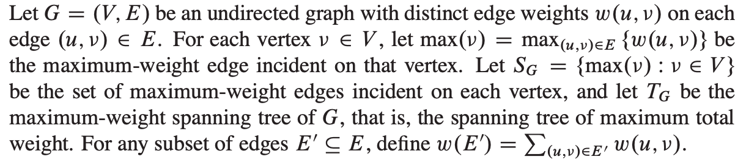
Approximating a Maximum Spanning Tree Problem

Slide 4
1
3
4
6
5
1
2
S(G)
T(G)
i
1
3
3
3
4
4
6
6
6
5
5
5
1
max(i)
2

Slide 5
1
3
4
5

Slide 6
G
S(G)
T(G)
1
1
3
3
3
6
6
6
1
2
2
2

Slide 7


Slide 8
Consider Kruskal’s algorithm:
Sort the edges from largest to smallest weight,
Consider them one at a time in order, and if the edge doesn’t introduce a cycle, add it to the tree.

Slide 9
Proof by Contradiction
There is an edge (u, v) which is in S(G) and not in T(G)
max(u)
v
3
u
(u, v) is not added to the maximum spanning tree
So it must introduce a cycle

Slide 10
Proof by Contradiction
If (u, v) is introducing a cycle, there is some edge (u, w) which is already included in the spanning tree
max(u)
v
3
u
w
Removing (u,w) and adding (u, v) should lead to a better maximum spanning tree.

Slide 11
Proof by Contradiction
If by doing that a cycle appears, there were already a path between u and v
v
u
w
That path + (u, w) + the path from w to v, creates a cycle in the original spanning tree

Slide 12


Slide 13
Based on part c. all edges in S_{G} are already in T_{G}.
Therefore w(T_{G}) ≥ w(S_{G} ) ≥ w(S_{G} ) / 2

Slide 14
We also know that |T_{G}| = |V| - 1.
Suppose that T_{G} \ S_{G} includes all edges that are in T_{G} but not in S_{G} .
|T_{G} \ S_{G}| + |S_{G}| = |V| - 1
|S_{G}| ≥ |V |/2 (previous slide)
Therefore |T_{G} \ S_{G}| ≤ |V |/2 ≤ |S_{G}|.

Slide 15
Since every edge in T_{G} \ S_{G} is non-maximal,
each of these has weight less than the weight of any edge in S_{G}.
Let m be the minimum weight of an edge in S_{G}. Then w(T_{G}\S_{G}) ≤ m|S_{G}|, so w(T_{G}) ≤ w(S_{G}) + m|S_{G}| ≤ 2w(S_{G}). Therefore w(T_{G})/2 ≤ w(S_{G}).

Slide 16
Let N(v) denote the neighbors of a vertex v. An algorithm APPROX-MAX-SPANNING that finds S_{G} produces a subset of edges of a minimum spanning tree by part (c), and is a 2-approximation algorithm by part (d).

Slide 17
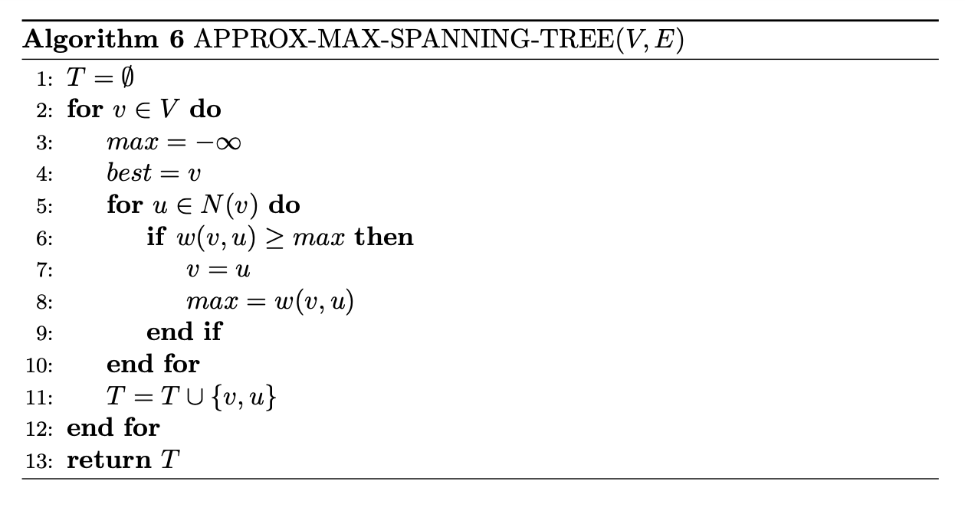
Let N(v) denote the neighbors of a vertex v. The following algorithm APPROX-MAX-SPANNING produces a subset of edges of a minimum spanning tree by part (c), and is a 2-approximation algorithm by part (d).

Slide 18
Dynamic Programming
Kiran Lekkala

Slide 19
DP Example-1
You are about to venture out of your home to go on a trek to Costco. You know the maximum weight W your car can carry and there is a set S of n potentially useful items you can buy from Costco (toilet paper, paper towels, margarita mix, etc). Each item i has a weight wi (a positive integer) and a benefit value bi (positive, not necessarily integer). Due to concerns about shortages, you are only allowed to buy 1 of each item from Costco. The goal is to select a subset of the items such that the total weight is at most W while maximizing the total benefit of the items. Give a dynamic programming algorithm to compute the largest subset of items you can buy from Costco, subject to the total weight constraint. Explain the complexity.

Slide 20

DP Example-1: Solution
You may recognize this as the 0-1 Knapsack Problem
Initialize OPT to be a matrix n+1 rows and W +1 columns. The first row corresponds to no more items, the first column corresponds to 0 weight. Fill the first row and the first column with 0s. This algorithm takes .
What if the value of each item is not limited (unbounded knapsack)?

Slide 21
DP Example-2
Given a value N, if we want to make change for N cents, and we have infinite supply of each of coins = { S1, S2, .. , Sm} valued coins, how many ways can we make the change? The order of coins doesn’t matter.
For example, for N = 4 and coins = {1,2,3}, there are four solutions: {1,1,1,1},{1,1,2},{2,2},{1,3}. So output should be 4. For N = 10 and S = {2, 5, 3, 6}, there are five solutions: {2,2,2,2,2}, {2,2,3,3}, {2,2,6}, {2,3,5} and {5,5}. So the output should be 5.

Slide 22



DP Example-2
Following is the recurrence relation:
Base cases:

Slide 23
DP Example-2
 | 0 | 1 | 2 | 3 | 4 | 5
{} | 1 | 0 | 0 | 0 | 0 | 0
{1} | 1 | 1 | 1 | 1 | 1 | 1
{1,2} | 1 | 1 | 2 | 2 | 3 | 3
{1, 2, 5} | 1 | 1 | 2 | 2 | 3 | 4

Slide 24
Linear Programming (LP)
Ta-Yang Wang

Slide 25
Problem
A company produces two kinds of products. A product of the first type requires 2 hours of assembly labor, 1 hour of testing, and 2 dollar worth of raw materials. A product of the second type requires 3 hours of assembly, 3 hours of testing and 1 dollar worth of raw materials. Given the current personnel of the company, there can be at most 90 hours of assembly labor and 80 hours of testing, each day. Products of the first and second type have a market value of 9 dollar and 7 dollar respectively. Suppose that up to 50 hours of overtime assembly labor can be scheduled, at a cost of 2 dollar per hour. Formulate a linear programming problem that can be used to maximize the daily profit of the company.

Slide 26
Solution
Variables
x: number of products of first type produced
y: number of products of second type produced
z: overtime in assembly (hours)
Objective function
max 7x+6y-2z (daily profit: market value - raw material cost - overtime cost)
Constraints
2x+3y-z <= 90 (hours for assembly work)
x+3y <= 80 (hours for testing)
z <= 50 (hours for overtime assembly)
x,y,z >= 0

Slide 27
Greedy (Approximation)
TA: Alex Wang

Slide 28
Knapsack Approximation
Consider the 0 - 1 knapsack problem. Give an O(nlogn) algorithm that gives an ½ approximation. None of the items have weight greater than the total capacity.
Hint: be greedy

Slide 29
Solution
Let algorithm A be sorting the elements by decreasing value, and selecting as many elements until your bag cannot hold anymore. Let algorithm B be sorting the elements by decreasing value/weight density. Then we select items in this order to add to our bag until we do not have enough capacity to fit the next item. Now we run both algorithms and take the algorithm that returns the larger value. This will be a ½ approximation of the optimal solution.
Why?

Slide 30
Solution (continued)
Let OPT denote the optimal value, and V_{A} and V_{B} be values obtained from running the algorithms A and B, respectively. WLOG, assume that items 1, 2, …, k are the items that put into the bag with algorithm B, and that j is the first item that does not fit into the bag. Cleary the sum of values of 1, 2, …, k is equal to V_{B}, and V_{B} + v_{j} >= OPT. Now v_{j} <= V_{A}, since with algorithm A we start by taking the item with greatest value. Then we have that V_{A} + V_{B} >= OPT, meaning that at least one of V_{A} or V_{B} is greater than ½ OPT, so we are done.

Slide 32
Divide and Conquer
TA: Rutu Desai

Slide 33
Question.
Suppose you have a set of n identical gold bars, one of which is impure. The bars all look the same, however the impure bar is lighter by an unknown amount. You have a rudimentary weighing scale which you can use to compare the weight of two sets of objects. The scale tells you if its two sides weigh equal or tells you which side is lighter. Once you’re done using the scale, you’re charged an amount of 2^k if you used the scale k times, thus using it is very costly.
Design an algorithm to determine the impure bar while minimizing the worst-case charge for using the weighing scale (it should be strictly less than Theta(n)).

Slide 34
Solution
Algorithm:
Make three partitions, two of size (int) n/3, and the third with remaining bars.
Compare the first two partitions. If they are equal, the third partition contains the impure, if not the lighter of the two does.
Proceed with that partition and repeat till the resultant partition contains the sole impure bar.
The number of times the scale is used T(n) follows the recurrence T(n) = T(n/3) + 1, solving which gives T(n) = log₃ n, & a charge of Theta(n^ (log₃ 2))
Dividing into two halves at each stage, gets you to pay at most Theta(n)

Slide 35
Let A be an array of 27 gold bars and let 8th be an impure one.
A = [A0, A1, A2,.....A26]
Dividing it into 3 parts
P1 P2 P3
[A0…..A8] [A9…..A17] [A18…..A26]
[A0,A1,A2] [A3,A4,A5] [A6,A7,A8]
[A6] [A7] [A8]
Answer

Slide 36
Network Flow
Krishna Kadam

Slide 37
Problem
The computer science department at a major university has a tutoring program. There are m tutors, {t₁, . . . , t_{m}} and n students who have requested the tutoring service {s₁, . . . , s_{n}}. Each tutor t_{i} has a set T_{i} of topics that he/she knows, and each student s_{j} has a set of topics S_{j} that he/she wants help with. We say that tutor t_{i} is suitable to work with student s_{j} if S_{j} ⊆ T_{i}. (That is, the tutor t_{i} knows all the topics of interest to student s_{j}.) Finally, each tutor t_{i} has a range [a_{i} , b_{i} ], indicating that this tutor would like to work with at least a_{i} students and at most b_{i} students. Given a list of students, a list of tutors, the ranges [a_{i} , b_{i} ] for the tutors, and a list of suitable tutors for each student, present an efficient algorithm that determines whether it is possible to generate a pairing of tutors to students such that:
• Each student is paired with exactly one tutor.
• Each tutor t_{i} is paired with at least a_{i} and at most b_{i} students.
• Each student is paired only with a suitable tutor.

Slide 38
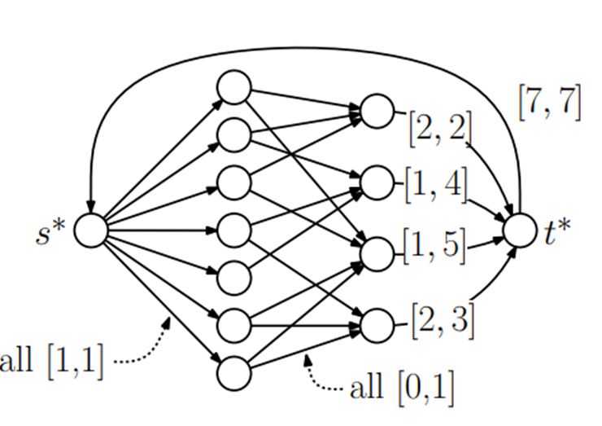
Solution
Construction:
First, we create student vertices {s₁, . . . , s_{n}} and tutor vertices {t₁, . . . , t_{m}}, a special source vertex s* , and a special sink vertex t* . All the node demands are set to 0.
We create the edges as follows:
• For each student s_{j} , create edge (s* , s_{j} ) of capacity [1, 1].
• For each suitable student-tutor pair, create edge (s_{j} , t_{i}) of capacity [0, 1].
• From each tutor t_{i} , create edge (t_{i} , t* ) of capacity [a_{j} , b_{j} ].
• Create an edge (t*, s* ) of capacity [n, n].

Slide 39
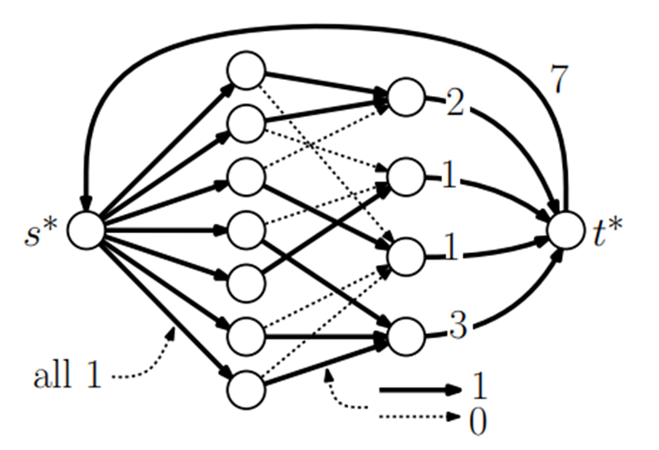
Solution
Claim: There is a feasible solution to the student-tutor pairing instance iff G has a feasible circulation.
Proof:
(⇒) If there is a valid student-tutor pairing, then G has a feasible circulation.
We create a circulation for G as follows,
By construction, there is a one unit of flow along each edge (s* , s_{j} ).
For edges (s_{j} , t_{i}), the flow is 1 if student s_{j} is paired with tutor t_{i}.
For each tutor t_{i} , let c_{j} denote the number of students paired to this tutor.
We set the flow along edge (t_{i} , t* ) to c_{j} .
Finally, we set the flow along edge (t* , s* ) to n.
Thus, there is a feasible circulation in G. Because the pairing is valid, each student is paired with exactly one tutor, and thus its demand of zero is satisfied. Also, each tutor is paired with between a_{i} to b_{i} students, and so its flow demand is also satisfied.

Slide 40
Solution
(⇐) If there is a feasible circulation for G, then there is a feasible student-tutor pairing.
Because the edge capacities are integers, we may assume that this is an integer flow. We define a pairing as follows. This is a valid student-tutor pairing because
1. Demands are all zero, and each student has an incoming capacity of [1, 1] it follows that each student is paired with exactly one tutor.
2. Each tutor has an outgoing capacity of [a_{i} , b_{i} ], it follows that each tutor is paired with the appropriate number of students.
3. We only create edges between suitable student-tutor pairs, thus the pairings selected are all suitable.

Slide 41
P/NP and reductions

Slide 42
NP- True / False Questions
If INDEPENDENT SET can be reduced to a decision problem X, then X can be reduced to INDEPENDENT SET.

Slide 43
If INDEPENDENT SET can be reduced to a decision problem X, then X can be reduced to INDEPENDENT SET.
False. If X is in NP, then it would be guaranteed true, but cannot claim without that information.

Slide 44
NP- True / False Questions
All the NP-hard problems are also in NP.

Slide 45
All the NP-hard problems are also in NP.
False. The NP-hard problems that are in NP are called NP-complete but that’s only a subset of the NP-hard problems.

Slide 46
NP - Multiple choice Questions
The problems 3-SAT and 2-SAT are
both in P
both NP-complete
NP-complete and in P respectively
undecidable and NP-complete respectively

Slide 47
NP - Multiple choice Questions
The problem 3-SAT and 2-SAT are
both in P
both NP-complete
NP-complete and in P respectively
undecidable and NP-complete respectively
c) is correct

Slide 48
NP - Multiple choice Questions
Which of the following statements are TRUE?
a) The problem of determining whether there exists a cycle in an undirected graph is in P.
b) The problem of determining whether there exists a cycle in an undirected graph is in NP.
c) If a problem A is NP-Complete, there exists a non-deterministic polynomial time algorithm to solve A.

Slide 49
NP - Multiple choice Questions
Which of the following statements are TRUE?
1) The problem of determining whether there exists a cycle in an undirected graph is in P.
2) The problem of determining whether there exists a cycle in an undirected graph is in NP.
3) If a problem A is NP-Complete, there exists a non-deterministic polynomial time algorithm to solve A.
All are correct. Detecting a cycle in an undirected graph can be done with a DFS, thus in P. Since it is in P, it is in NP as well. Since the problem A is NP-Complete, it is in NP and thus, there exists a non-deterministic polynomial time algorithm to solve A.

Slide 50
NP - Long Question 1
Suppose you move to a new city. The city is defined by a directed graph G=(V,E) and each edge e ∈ E has a non-negative cost c_{e} associated to it. Your living place is represented as a node s ∈ V. There is a set of landmarks X (a subset of V), which you want to visit. To plan your roaming around efficiently, you are interested in finding a subgraph G’=(V’,E’) that contains a path from s to each x ∈ X while minimizing the total edge cost of E’. The decision problem (call it ROAM) is, given a graph G=(V,E) with non-negative costs, vertex subset X of V, a node s ∈ V, and a number k, does there exist a subgraph G’=(V’,E’) that contains a path from s to each x ∈ X, having a total edge cost of E’ at most k? Show that ROAM is NP-complete with a reduction from SAT.

Slide 51
Suppose you move to a new city. The city is defined by a directed graph G=(V,E) and each edge e ∈ E has a non-negative cost c_{e} associated to it. Your living place is represented as a node s ∈ V. There is a set of landmarks X (a subset of V), which you want to visit. To plan your roaming around efficiently, you are interested in finding a subgraph G’=(V’,E’) that contains a path from s to each x ∈ X while minimizing the total edge cost of E’. The decision problem (call it ROAM) is, given a graph G=(V,E) with non-negative costs, vertex subset X of V, a node s ∈ V, and a number k, does there exist a subgraph G’=(V’,E’) that contains a path from s to each x ∈ X, having a total edge cost of E’ at most k? Show that ROAM is NP-complete with a reduction from SAT.
Show that ROAM is in NP
Solution: We show that a subgraph G’ as a certificate. Certifier checks that all the nodes in X are reachable - can be done using DFS, thus in poly-time. Then check the total edge weight is within k - doable in linear (hence poly-) time.

Slide 52
Suppose you move to a new city. The city is defined by a directed graph G=(V,E) and each edge e ∈ E has a non-negative cost c_{e} associated to it. Your living place is represented as a node s ∈ V. There is a set of landmarks X (a subset of V), which you want to visit. To plan your roaming around efficiently, you are interested in finding a subgraph G’=(V’,E’) that contains a path from s to each x ∈ X while minimizing the total edge cost of E’. The decision problem (call it ROAM) is, given a graph G=(V,E) with non-negative costs, vertex subset X of V, a node s ∈ V, and a number k, does there exist a subgraph G’=(V’,E’) that contains a path from s to each x ∈ X, having a total edge cost of E’ at most k? Show that ROAM is NP-complete with a reduction from SAT.
Hints for construction
‘Satisfy ALL clauses’ VS ‘Reach ALL nodes in X’
Variables serve as ways to satisfy clauses VS nodes/edges in G serve as ways to satisfy the reachability constraints of X,

Slide 53
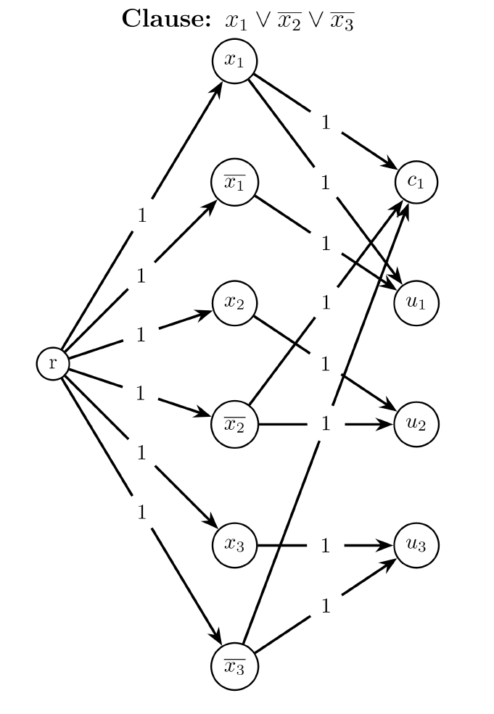
(b) Reduction from SAT: Construct
A new node r for living place.
Nodes x_{i} and ~x_{i} for each variable, all connected to r.
Nodes c_{i} for each clause, connected to its literals.
Nodes u_{i} for each variable, connected to x_{i} & ~x_{i}
All edges have weight 1.
Subset X contains all u_{i} and c_{i}
K = 2n + m (as used in the claim next) (n = #vars, m = #clauses)

Slide 54
(b) Construction:
A new node r for living place. Nodes x_{i} and ~x_{i} for each variable, all connected to r.
Nodes c_{i} for each clause, connected to corresponding literals.
Nodes u_{i} for each variable connected to x_{i} and ~x_{i}
All edges have weight 1.
Subset X contains all u_{i} and c_{i}
(c) Claim: Given 3-SAT instance (i.e. the 3CNF formula) has a solution (i.e. a satisfying assignment) if and only if the constructed graph has a subgraph G’ containing paths from r to each x in X, with total edge weight at most 2n + m

Slide 55
(d) SAT has a satisfying assignment => Constructed graph has a subgraph with routes from r to each x in X with weight at most 2n + m
Proof: Consider the satisfying assignment. For any x_{i}, let L_{i} be the literal that is true (i.e. x_{i} or ~x_{i}). Construct the subgraph by including
1) The nodes corresponding to each L_{i} (alongwith the source node r & all the destination nodes u_{i} and c_{j})
2) All the edges r -> L_{i} and L_{i} -> u_{i} so that u_{i} is reachable from r (thus, 2n such edges). Further, since the subgraph is constructed from a satisfying assignment, some literal in each clause is true and we add the edge from the corresponding literal node to the clause node (thus, m such edges) so that all c_{j} are reachable.

Slide 56
(e) Constructed graph has a subgraph spanning X with weight at most 2n + m => SAT has a satisfying assignment
Proof: Consider the spanning subgraph H.
H must have the node L_{i} and edges r -> L_{i} and L_{i} -> u_{i} for either L_{i} = x_{i} or L_{i} = ~x_{i} so that u_{i} is reachable from r (thus, 2n such edges, and n nodes).
Further, for each clause, there must be an edge in H from the literal node to the clause node (thus, m such edges) so that it’s reachable from r. Additionally if this literal is not already included from 1), there must be an edge from r to this literal to make the clause node reachable.
Since H has a total edge weight at most 2n + m, it must have precisely the n nodes and 2n+m edges mentioned above. Then, we obtain an assignment by setting each x_{i} to true/false so as to make the corresponding L_{i} (that is included in H) true. This is a complete assignment since H includes a node for each variable as shown in 1). Further this is a satisfying assignment since for each clause, one of the literals (which makes it reachable from r in H) becomes true, thus satisfying the clause.

Slide 57
NP - Long Question 2
In a graph G, we say that 3 nodes form a triangle if each pair is connected by an edge. Given an undirected graph G = (V, E), and positive integers p, q, the triangle-rich subgraph problem (TRIRICH) asks if there exists a subgraph G’ with at most p vertices, having at least q triangles in it. Show that TRIRICH is NP-complete.

Slide 58
In a graph G, we say that 3 nodes form a triangle if each pair is connected by an edge. Given an undirected graph G = (V, E), and positive integers p, q, the triangle-rich subgraph problem (TRIRICH) asks if there exists a subgraph G’ with at most p vertices, having at least q triangles in it. Show that TRIRICH is NP-complete.
TRIRICH is in NP: A subgraph G’ is a certificate. The certifier checks if it has at most p nodes. For each triplet of nodes, we can check if they form a triangle, and thus, count the total in (cubic) poly-time and check if it is at least q.

Slide 59
In a graph G, we say that 3 nodes form a triangle if each pair is connected by an edge. Given an undirected graph G = (V, E), and positive integers p, q, the triangle-rich subgraph problem (TRIRICH) asks if there exists a subgraph G’ with at most p vertices, having at least q triangles in it. Show that TRIRICH is NP-complete.
TRIRICH is NP-hard: Reduction from CLIQUE (~ If a graph G has a clique of size at least k)
Given the input G, k, simply create the TRIRICH instance (G, k, ^{k}C₃). If k = 1, return YES if G has a vertex, otherwise no
If k = 2, return YES if G has at least 1 edge, otherwise no
If k ≥ 3, return TRIRICH(G, k, ^{k}C₃).
G has a clique of size ≥ k iff G has a subgraph of size at most k having at least ^{k}C₃ triangles.

